Slide 1
Capstone Project
Identify safe and secure hotels for consultants
By: Mal Thippana

Slide 2
Background
Top consulting companies such as Ernest & Young, Delloite, Pricewater coopers, Boston Consulting, KPMG hire consultants to work at their client locations. During the period of their assignment, they travel to these client locations from their homes and stay in hotels and eat out. All these boarding and lodging expenses are reimbursed by the consulting company. The consulting company interns would have accounted for all these expenses in finalizing the billing rate with the client. In the interest and safety of their consultants, the company allows their consultant to stay best and safe locations regardless of the daily hotel rate.
Business Problem
Since consultants have to stay near client location, it is good idea for the consulting companies to identify safe and nearby hotels and write a contract with the hotels. That way, the consulting company can get a better rate and pass those savings to the client to be competitive with other competing companies. It also provides a comfort to the consultants because they are staying at preferred hotels.
We are going to apply data science technology to identify best and safe hotels in New York

Slide 3
Data acquisition and cleaning
New York City Data containing Boroughs, Neighborhoods along with their latitude and longitude. Data Source: https://cocl.us/new_york_dataset
New York City 2019 YTD crime data a. Data Source: https://data.cityofnewyork.us/resource/5uac-w243.json
Hotel data using Foursquare API
GeoSpace data to draw / visualize choropleth map a. Data Source: https://data.cityofnewyork.us/City-Government/Borough-Boundaries/tqmj-j8zm & https://data.cityofnewyork.us/Public-Safety/Police-Precincts/78dh-3ptz
Top 50 Neighbourhoods in New York a. https://www.dnainfo.com/crime-safety-report/ranking. The data from this page has been curated into NY_top_50_safe_neighbourhoods.csv file in GITHUB
Precincts data for New York https://www1.nyc.gov/site/nypd/bureaus/patrol/precincts-landing.page

Slide 4
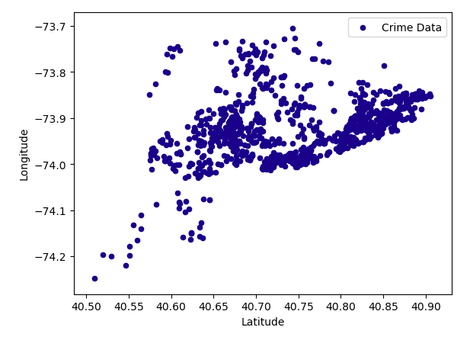
YTD Crime data
This scatter plotter is drawn with axis Latitude and Longitude shows geo special view of crimes. It shows certain neighborhoods have high crime rates.
I took the mean of the crime count and selected neighborhoods that are have less than the overall mean crime count

Slide 5
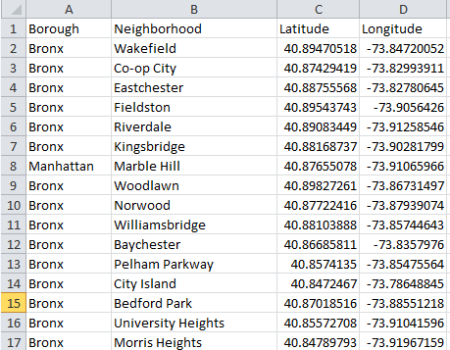
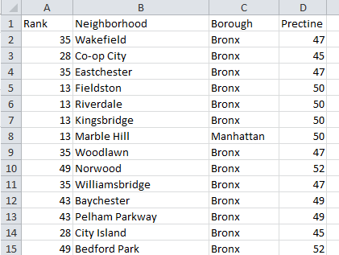
New York Neighborhoods
There are about 306 neighborhoods in New York. However we are going to select only top 50 based on safety ranking from https://www.dnainfo.com/crime-safety-report/ranking
All neighborhoods
Curated Top 50 safe neighborhoods

Slide 6
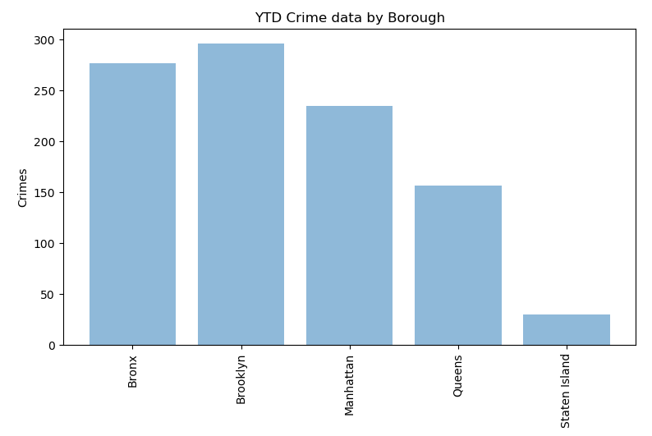
Crime Rate/Count by Borough
Based on YTD crime data grouped by Borough

Slide 7
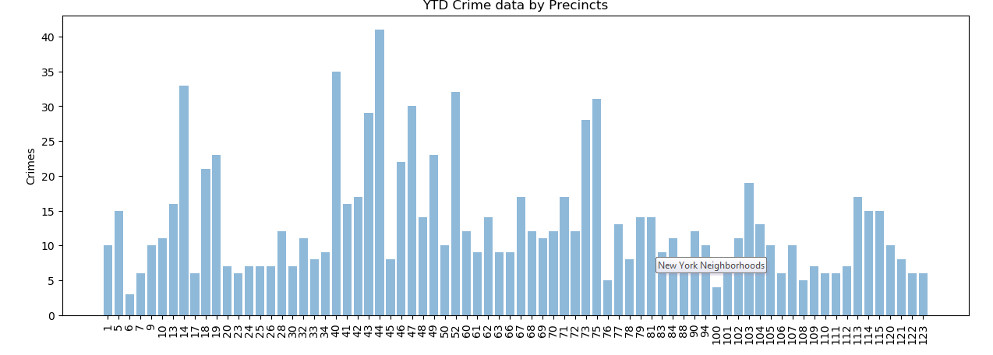
Crime Rate/Count by Precinct
Based on YTD crime data grouped by precinct
We are going to find the mean of crime count and select the precincts that have less than the mean crime count. After that we will match each precinct with already short listed top 50 neighborhoods.

Slide 8
Get the Hotel List
We are now going to use Foursquare API to select all venues that are in hotel category
Hotel: 4bf58dd8d48988d1fa931735
Bed & Breakfast: 4bf58dd8d48988d1f8931735
Boarding House: 4f4530a74b9074f6e4fb0100
Hostel: 4bf58dd8d48988d1ee931735
Hotel Pool:4bf58dd8d48988d132951735
Inn: 5bae9231bedf3950379f89cb
Motel: 4bf58dd8d48988d1fb931735
Resort:4bf58dd8d48988d12f951735

Slide 9
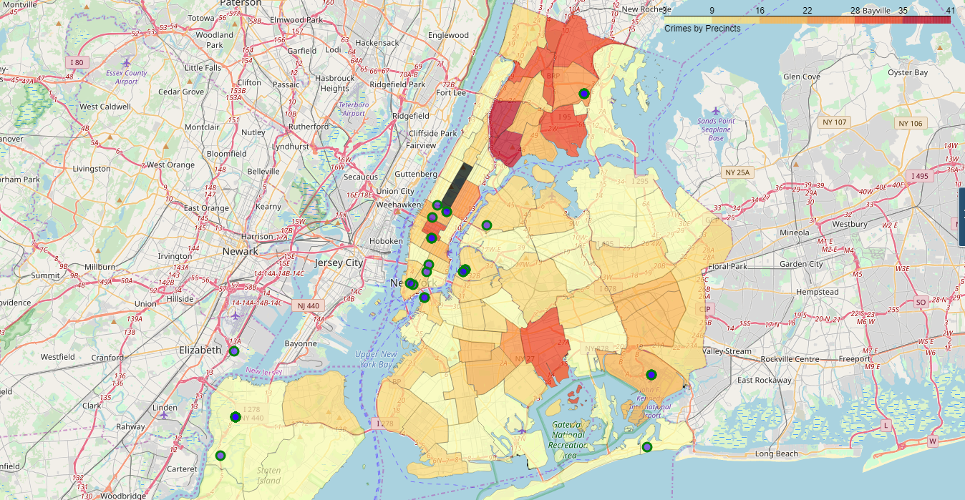
Results
We found 41 hotels that meets the criteria.
https://github.com/malthippana/Coursera_Capstone/blob/master/Crimes_by_Precincts.html

Slide 10
Conclusions
1. We eliminated neighborhoods that are less safe (selected top 50)
2. We eliminated neighborhoods based on recent crime rate (2019 YTD)
3. We were able to find 41 hotels from good/safe neighbourhoods.
4. Off 306 Potential good neighborhood names are about 25
'Co-op City' 'City Island' 'Throgs Neck' 'Pelham Bay' 'Greenpoint' 'Williamsburg' 'Cobble Hill' 'Carroll Gardens' 'Red Hook' 'East Williamsburg' 'Upper West Side' 'Chelsea' 'Woodside' 'Sunnyside' 'South Ozone Park' 'Springfield Gardens' 'Rosedale' 'Rockaway Beach' "Mariner's Harbor" 'Port Ivory' 'New Springville' 'Travis' 'Westerleigh' 'Graniteville' 'Arlington' 'Bloomfield' 'Bulls Head' 'Elm Park' 'Turtle Bay' 'Willowbrook'
Limitations
We used historical data to predict future stays. It doesn't guarantee that, it is more safer. Any potential crimes may take place in the identified neighborhoods. So, we can consider few more variables like unemployment rate, housing, drug usage and other predictive models to enhance this model

